Slide 1


Association of Ohio Pedologists
The premier society of
Professional Soil Scientists
www.ohiopedologist.org/

Slide 2
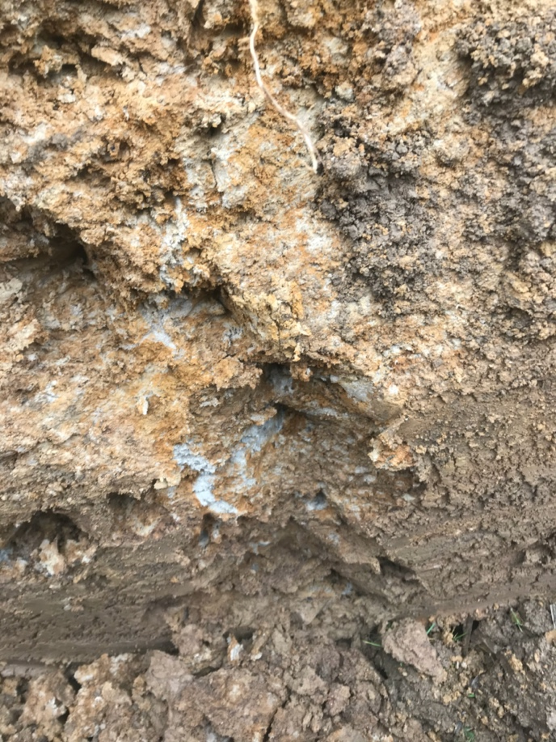
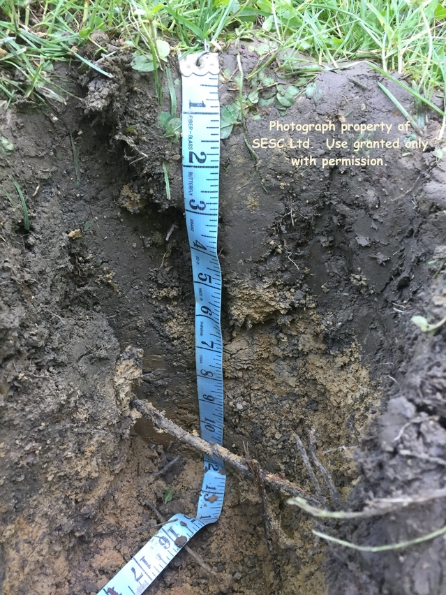
Association of Ohio Pedologists
What is a Pedologist?
A specialist with college education in soils,
field training, and real-world experience.
Pedology is one of the main
branches of soil science,
dealing with the formation,
description, and classification
of soils.
Photograph by Jeff Rice
www.ohiopedologist.org/

Slide 3
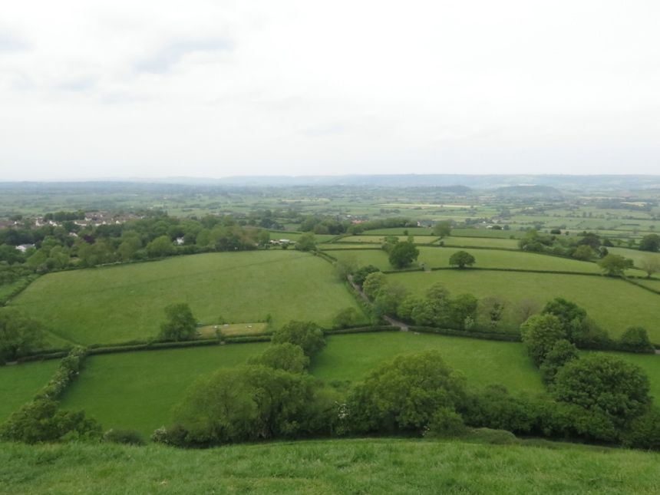
Association of Ohio Pedologists
What does AOP do?
Maintains professional standards for pedology and soil science.
Represents this scientific profession to legislative bodies, the courts, and the public.
Educates and disseminates information.
Encourages the appropriate use of professional pedological information.
www.ohiopedologist.org/

Slide 4
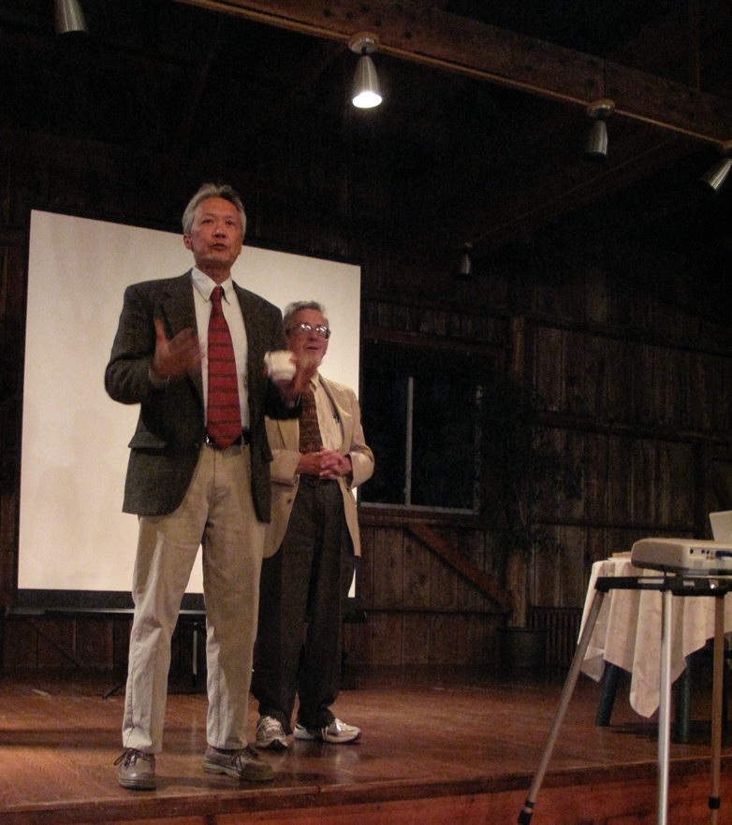
Association of Ohio Pedologists
The purpose of AOP:
Technically strengthens it’s members through continuing education.
Sets professional conduct for members.
Promotes recognition of the profession.
Determines and sets position statements on issues for the field.
www.ohiopedologist.org/

Slide 5
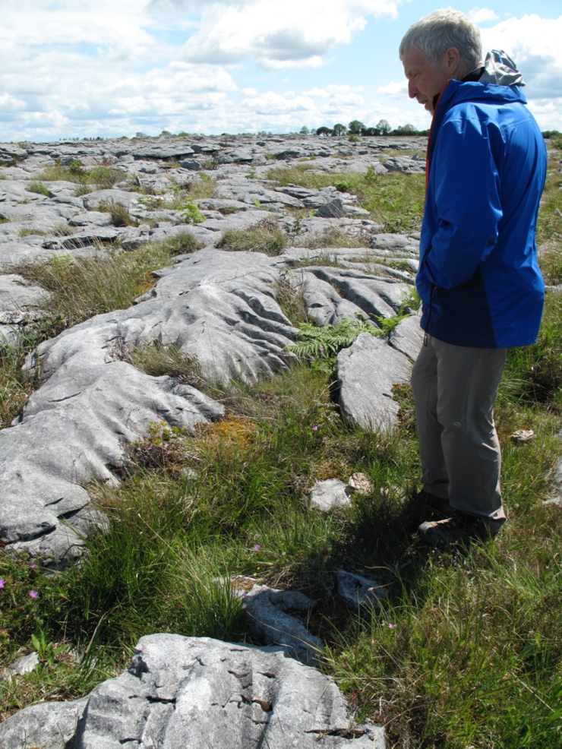
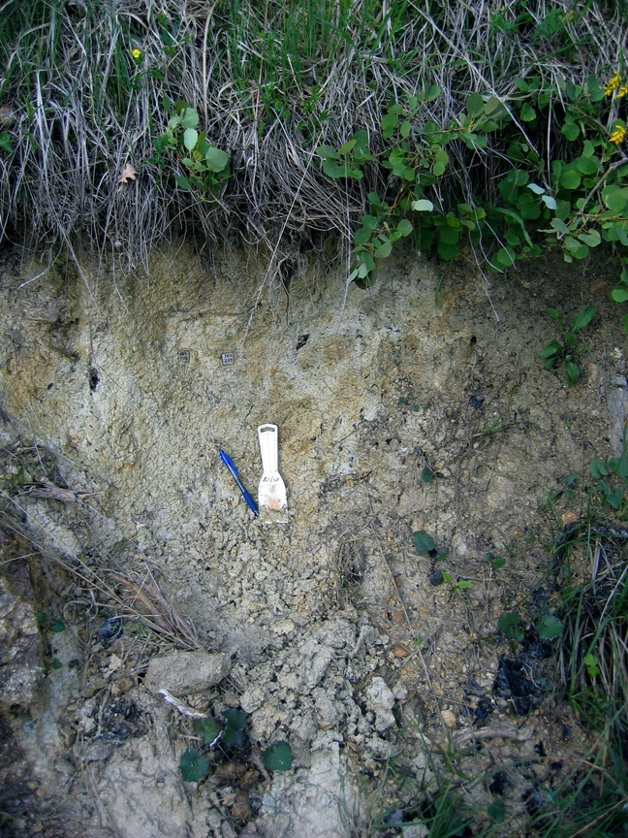
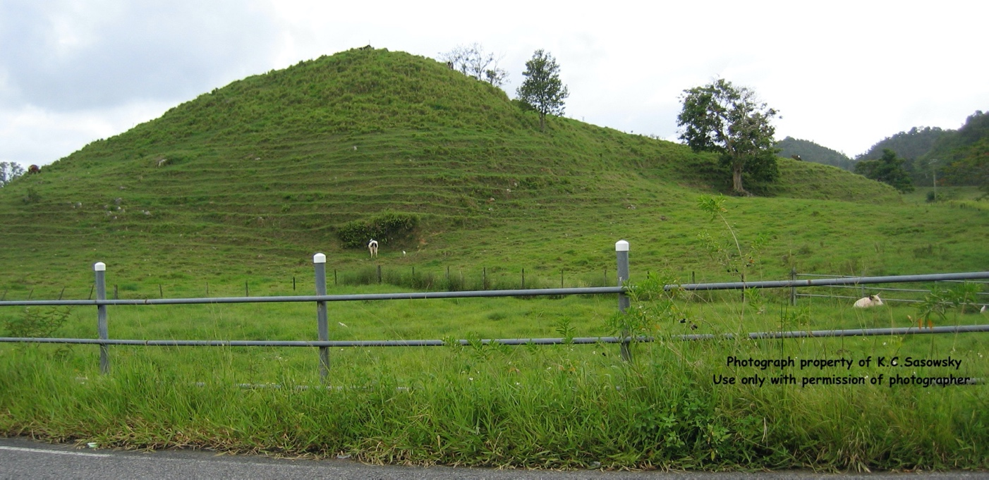
Association of Ohio Pedologists
Soil scientists:
Identify natural units on the landscape,
Differentiate soil types and document their location,
Describe soil characteristics and properties,
Recognize soil limitations for land uses, and
Promote wise utilization of the land.
www.ohiopedologist.org/

Slide 6
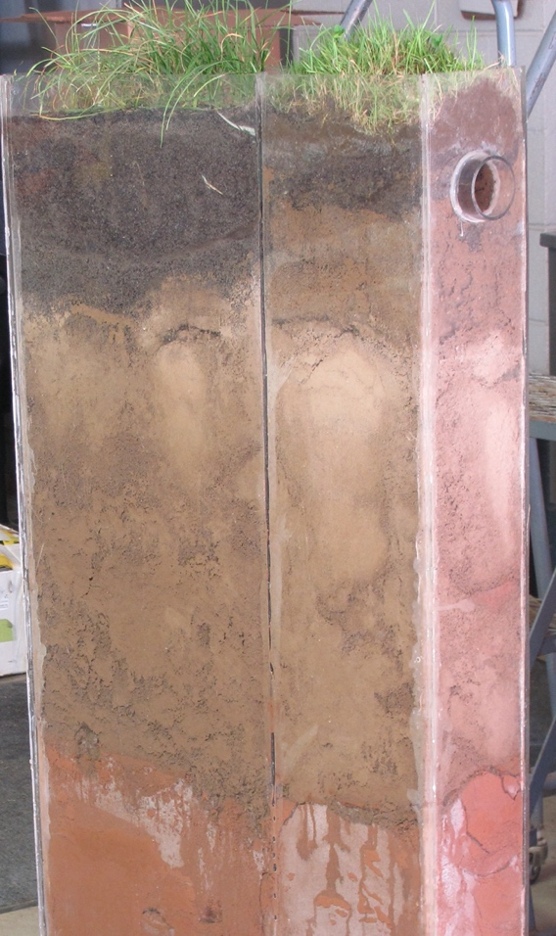
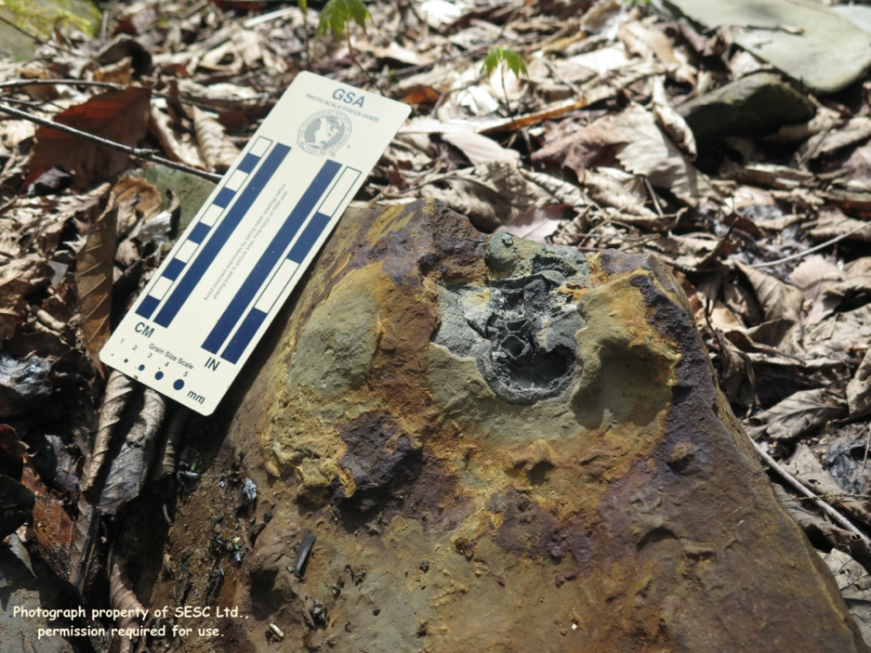
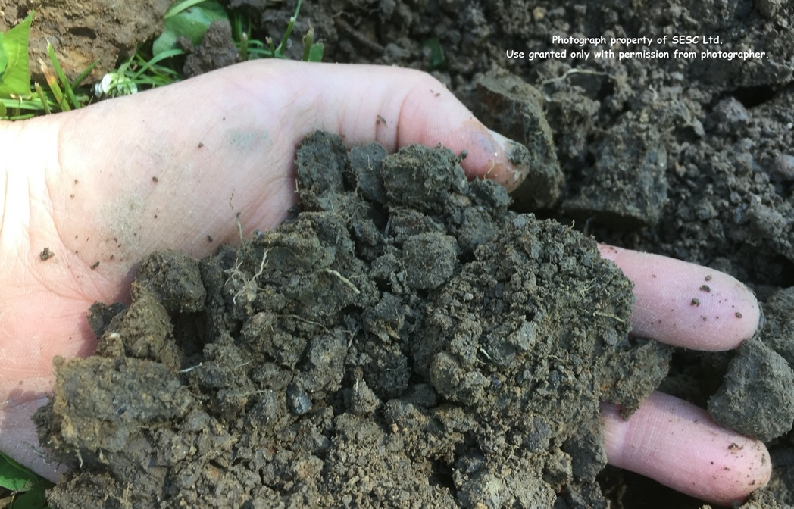
Association of Ohio Pedologists
Soil scientists:
Sample soils in place, analyze soil types in the field and in the laboratory for properties such as texture, color, horizonation,
parent material, wetness, depth to bedrock, chemistry, temperature, mineralogy, etc.
Construct and interpret manual and digital maps.
www.ohiopedologist.org/

Slide 7

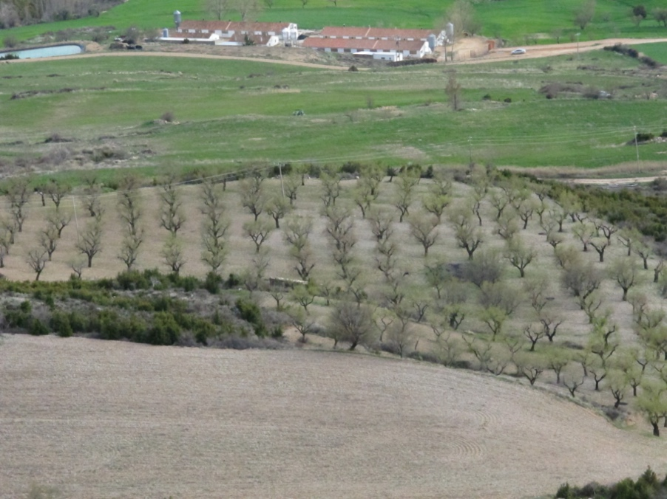
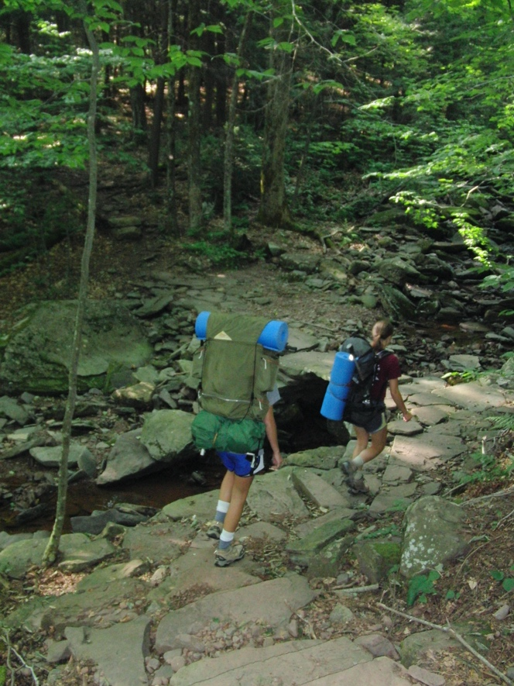
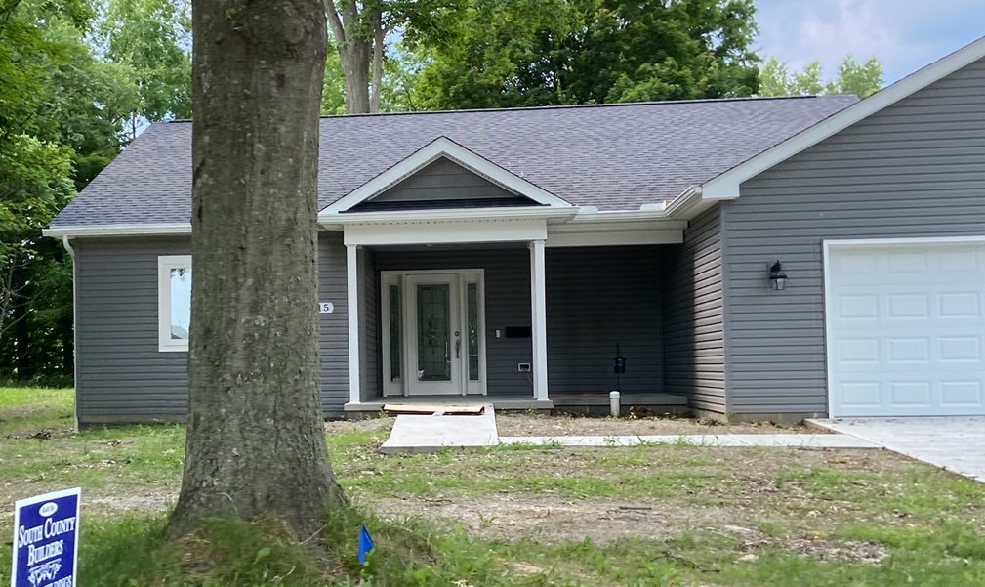
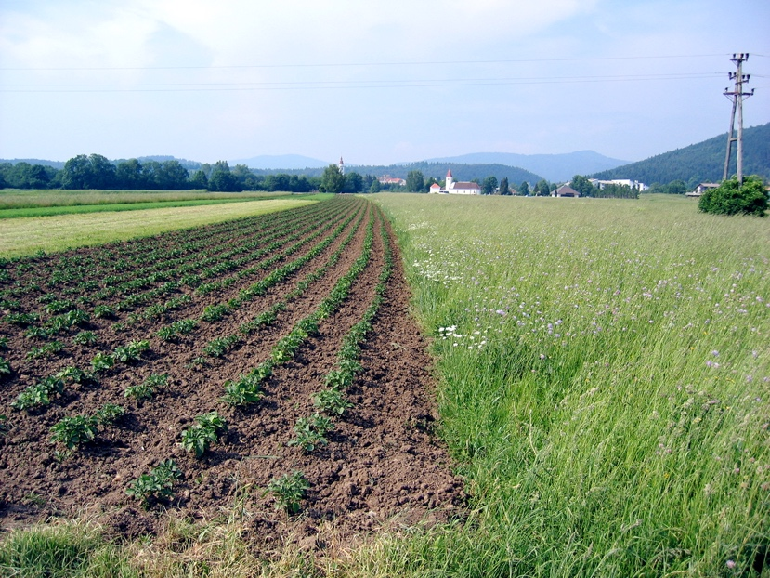
Association of Ohio Pedologists
Soil scientists:
Describe the suitability of the soil for various land uses:
on-site sewage treatment systems, dwellings,
roads, farming, recreational areas, etc.
www.ohiopedologist.org/

Slide 8
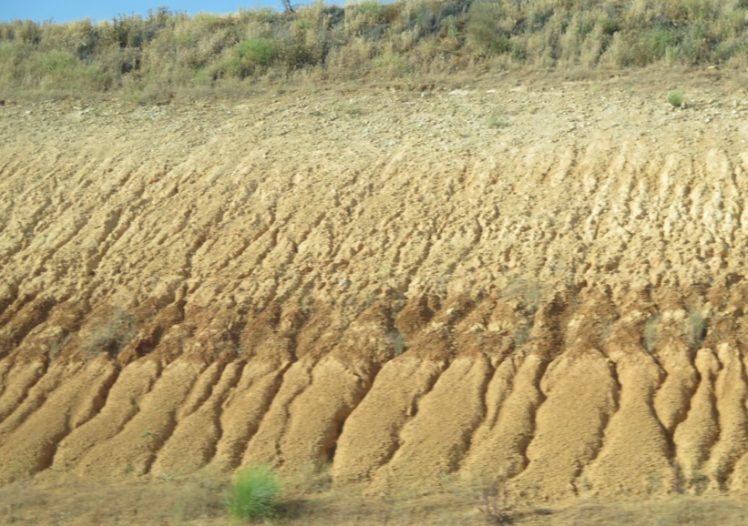

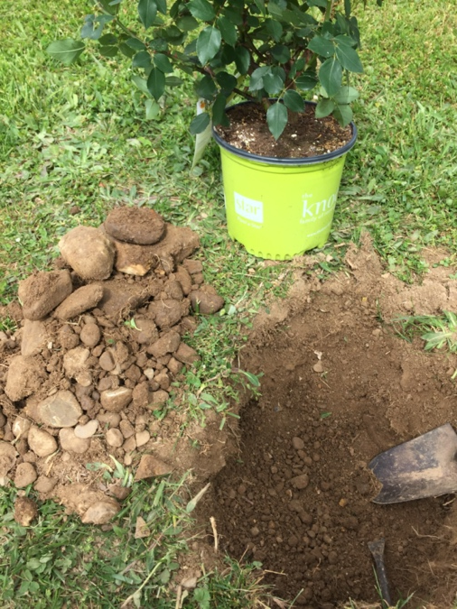
Association of Ohio Pedologists
Soil scientists:
Support soil erosion control, soil quality/health improvement, and management practices which are essential for maintaining Ohio’s economy.
Assist in food security.
Soils provide food, fiber, and fuel.
”Agriculture is the number-one contributor to Ohio’s economy.” “Farming also provides [results in] one out of eight jobs in Ohio!” (www.ohiolivestock.org)
www.ohiopedologist.org/

Slide 9
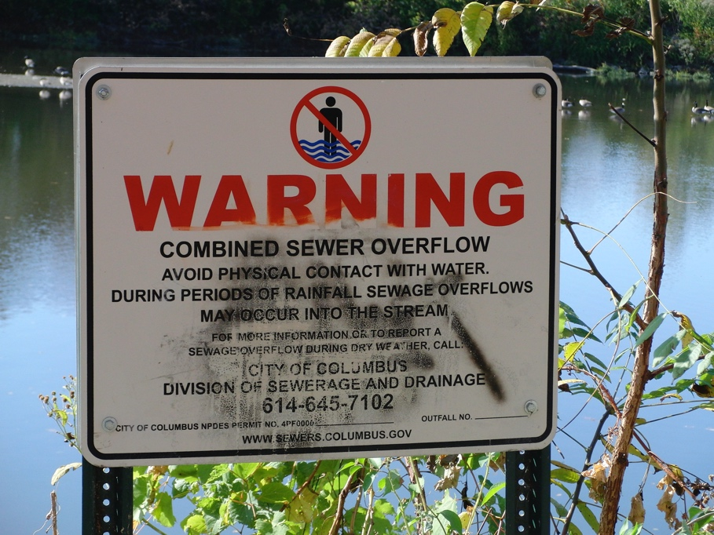
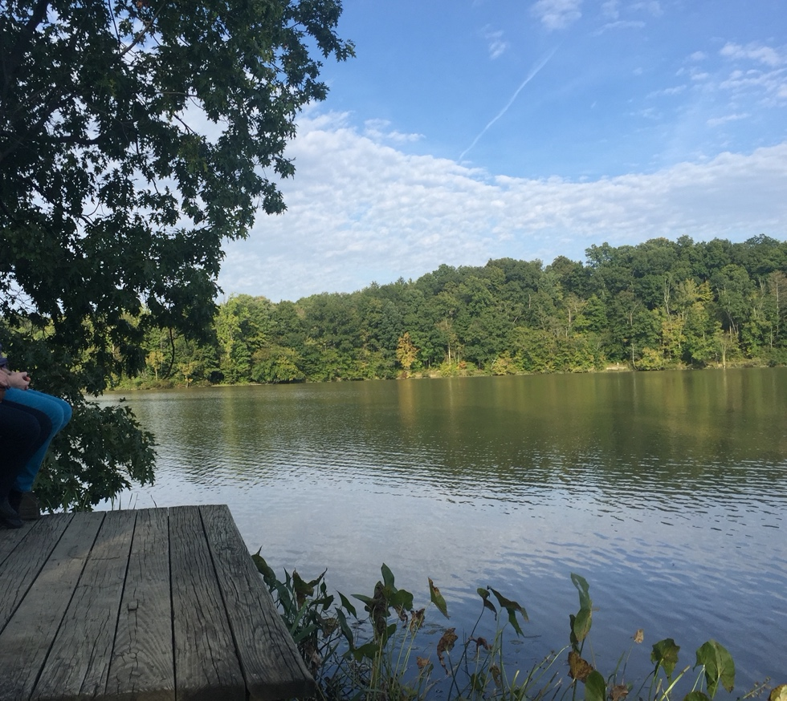
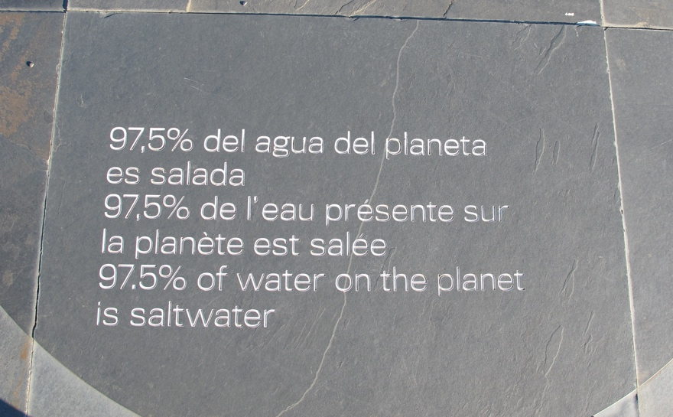
Association of Ohio Pedologists
Soil scientists:
Safeguard the public and the environment
by matching soil capability with land uses.
www.ohiopedologist.org/

Slide 10
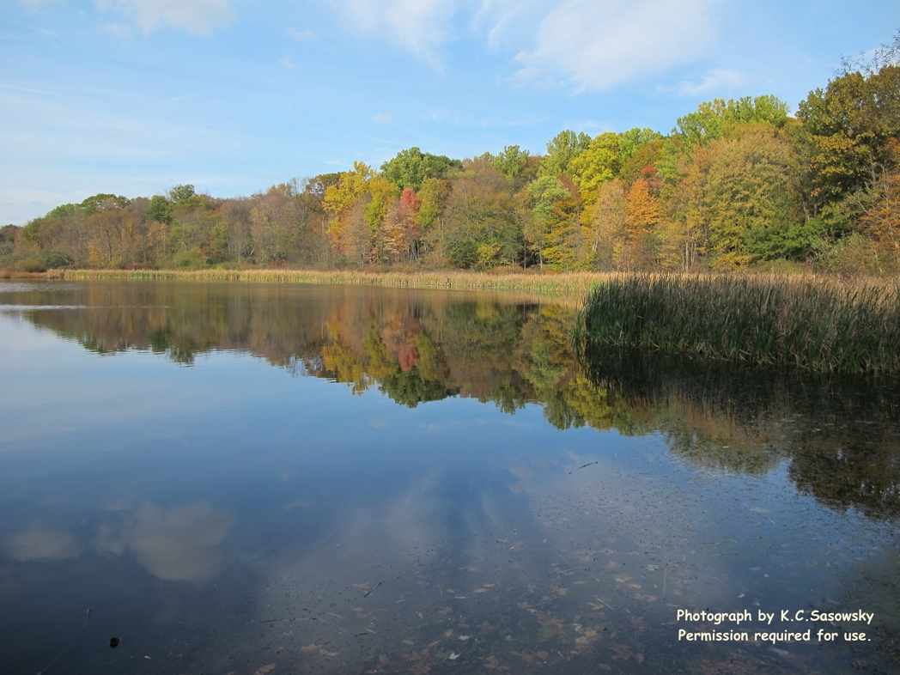
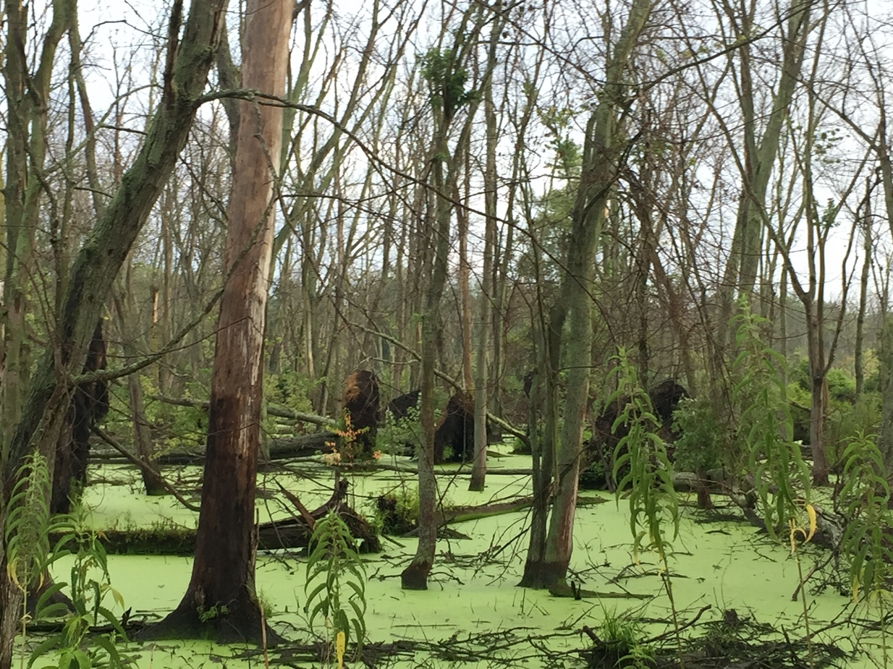

Association of Ohio Pedologists
Soil scientists:
Preserve wetlands which contain runoff, prevent flooding, filter pollutants out of water, recharge groundwater, and provide habitat for wildlife.
90% of Ohio’s original wetlands have been destroyed by draining and filling.
www.ohiopedologist.org/

Slide 11
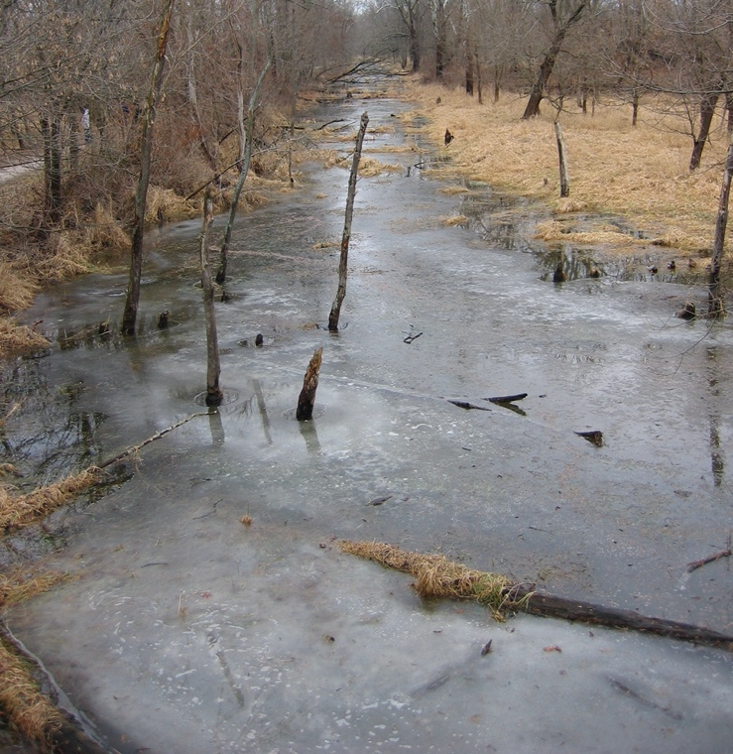
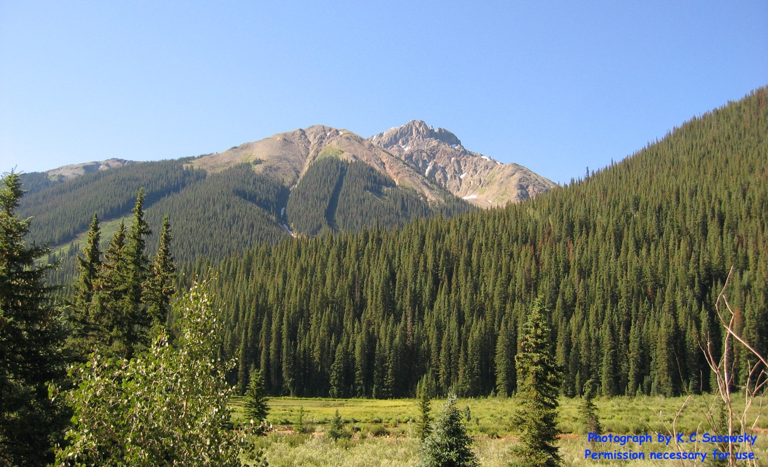
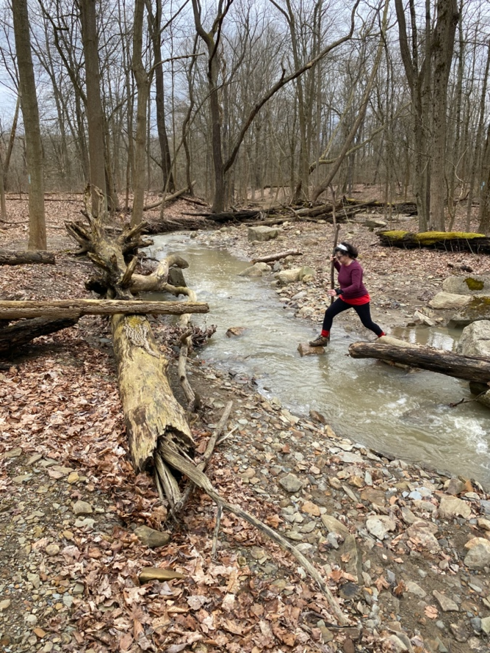
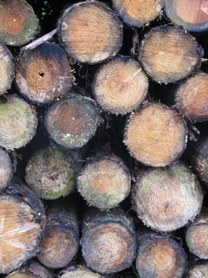
Association of Ohio Pedologists
Soil scientists:
Protect the public welfare from flooding hazards and slope instability.
Advise farmers and foresters about sustainable production.
www.ohiopedologist.org/

Slide 12
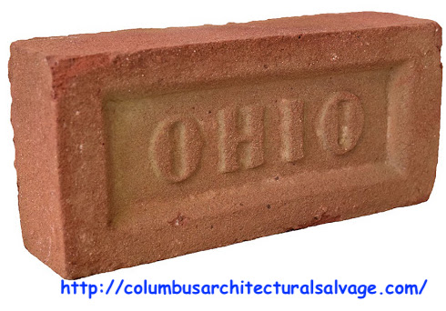

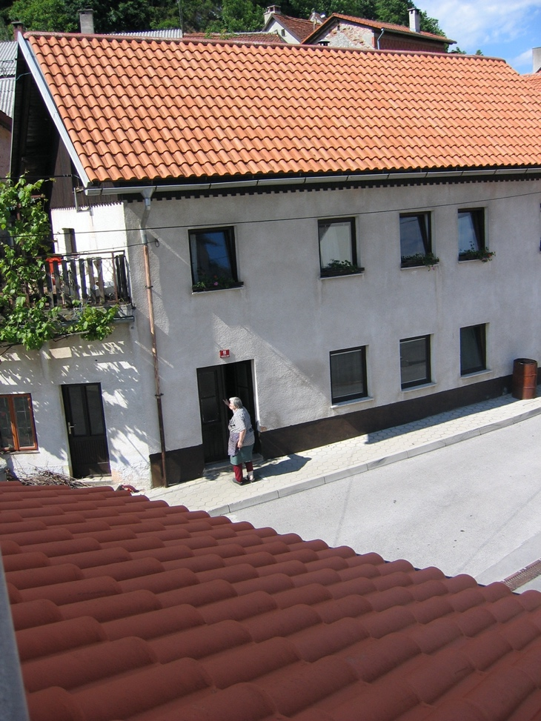


Association of Ohio Pedologists
Soil scientists:
Advise engineers and architects about construction and waste disposal.
Soil materials are building materials.
Soils provide building and road support.
www.ohiopedologist.org/

Slide 13

Association of Ohio Pedologists
Soil scientists:
Help solve climate change.
Work for sustainability.
Soil grows biofuels, can enhance soil quality, and capture carbon.
1/3 of the increase in carbon in the atmosphere is attributed to agricultural, forest, and soil management practices.
Protection of soil ensures sustainability.
www.ohiopedologist.org/

Slide 14
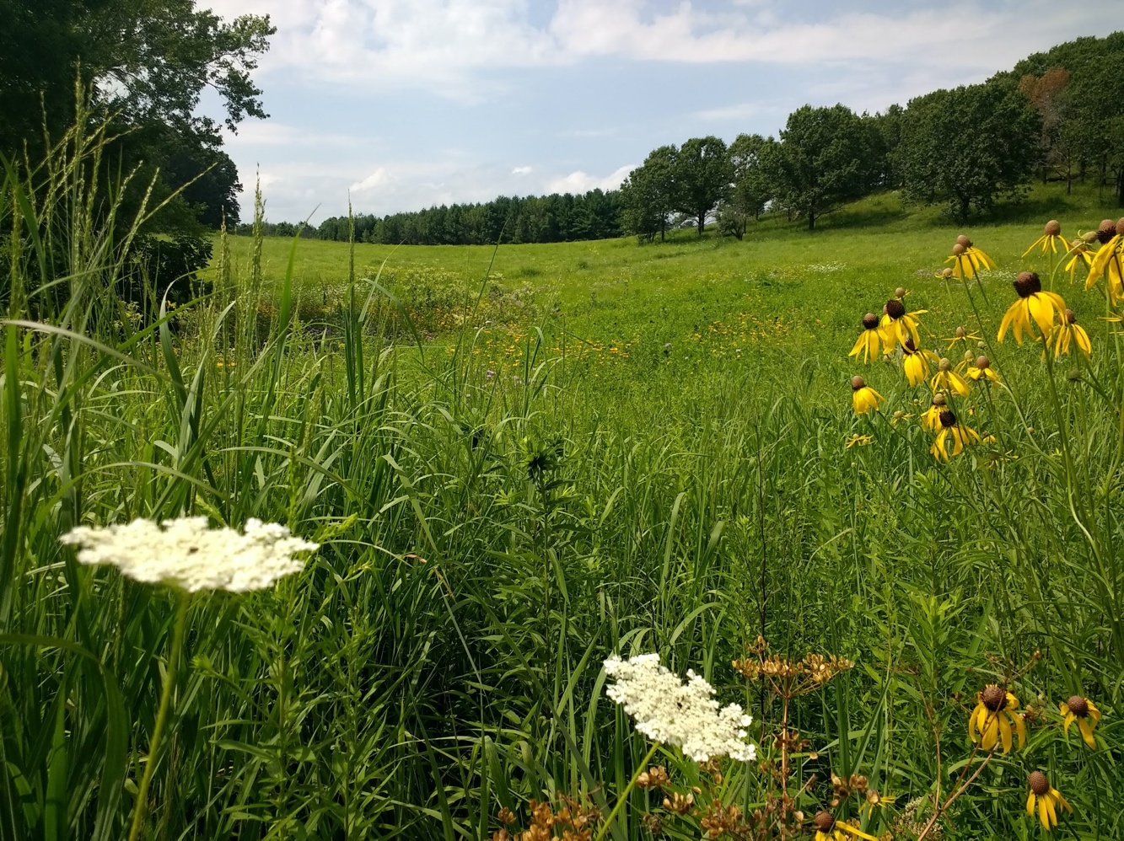
Association of Ohio Pedologists
Why join AOP?
Serve the profession.
Professional recognition.
Learn and grow.
Network with colleagues.
Apply to the Executive Council at:
www.ohiopedologist.org/membership.html
www.ohiopedologist.org/

Slide 15
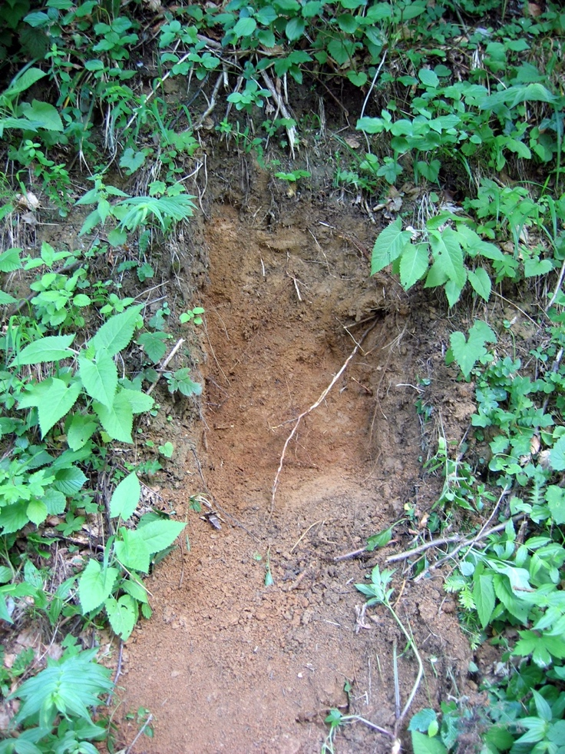
Association of Ohio Pedologists
Who is eligible to join AOP?
Professional Membership is available to those engaged in a soil resource-related profession with at least 3 years of relevant experience and skills.
In order to qualify for Professional Membership,
a B.S. in a related field with 15 semester or 23 quarter hours of soils courses are required.
Apply to the Executive Council at:
www.ohiopedologist.org/membership.html
www.ohiopedologist.org/

Slide 16
Association of Ohio Pedologists
Who is eligible to join AOP?
Affiliate Membership is available to those engaged in a soil resource-related profession with less than 3 years of relevant experience and skills.
In order to qualify for Affiliate Membership, a B.S. in a related field with 15 semester or 23 quarter hours of soils courses are required.
It is also available to those without the required credit hours, but with an interest in the objectives of AOP.
Apply to the Executive Council at:
www.ohiopedologist.org/membership.html
www.ohiopedologist.org/

Slide 17

Association of Ohio Pedologists
Who is eligible to join AOP?
Student Membership is available to those enrolled at least half-time at an institution of higher education offering course work in pedology and soil science, or related subjects.
In order to qualify for Student Membership, a person must be preparing for entrance into the profession, or with an interest in pedology.
Apply to the Executive Council at:
www.ohiopedologist.org/membership.html
www.ohiopedologist.org/

Slide 18
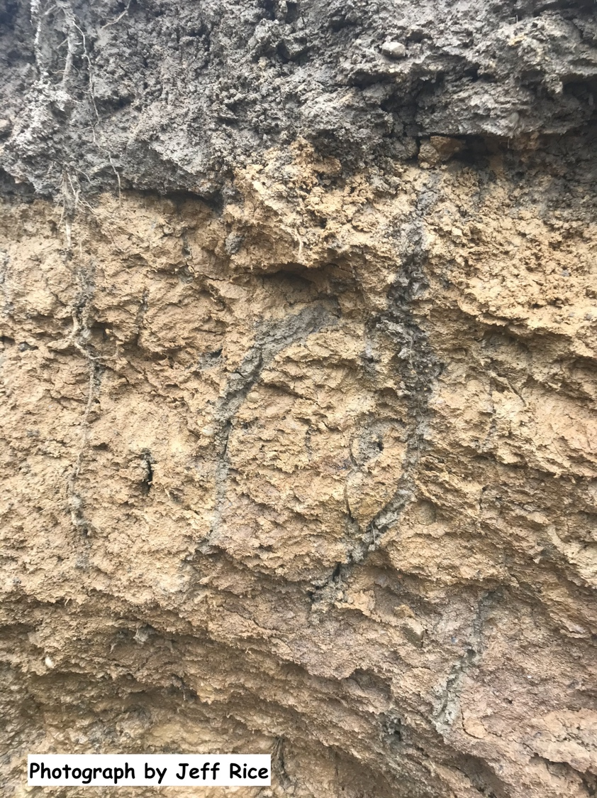


Association of Ohio Pedologists
AOP aspires to partner with organizations,
agencies, or businesses who support the
mission of the Association.
This material is intended for non-profit use by the Association of Ohio Pedologists (AOP). Created by Kathryn Connors Sasowsky. It is based on text from the AOP website (approved by AOP Executive Councils and membership votes) as well as personal and professional photographs, credited as noted.
Non-AOP use is not authorized.
www.ohiopedologist.org/

